Slide 1
Build your own Branded 3D Geospatial Data Explorer
with TerriaJS
Nanda Sankaran, Stafford Smith, Brendon Ward, Nick Forbes-Smith
October 2023, FOSS4G-Oceania, Auckland

Slide 2
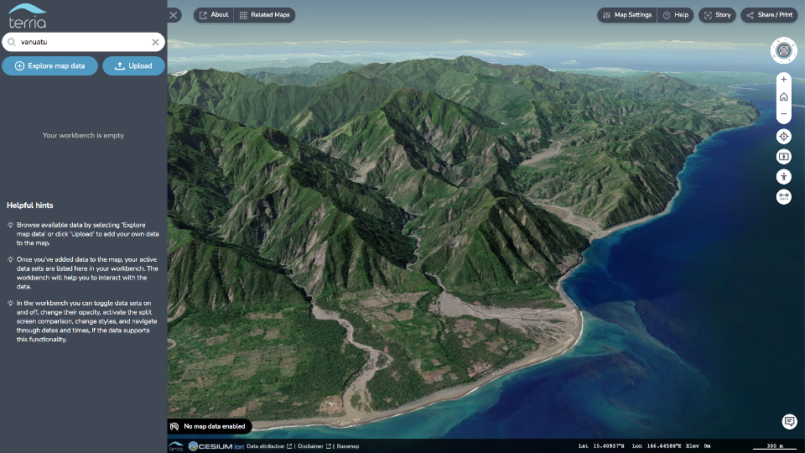
Before we start
Introductions

Slide 3

Brendon
Geospatial Engineer @ Terria
Previously
GIS Tech Lead – on a project using UAV for imagery and LIDAR, fleet and plant management
Software Architect – IMOS global marine observing system

Slide 4

Nanda
Software Engineer, Data61 CSIRO
Interests:
3D Graphics,
Building interactive 3D tools,
Data visualization
Passionate about making Terria usable
for non-experts.

Slide 5

Nick
Engineering Planning Lead for Terria
Background
Cloud-native geospatial
Fullstack web developer
Data visualisation
Focus on improving open data accessibility through open-source software!

Slide 6
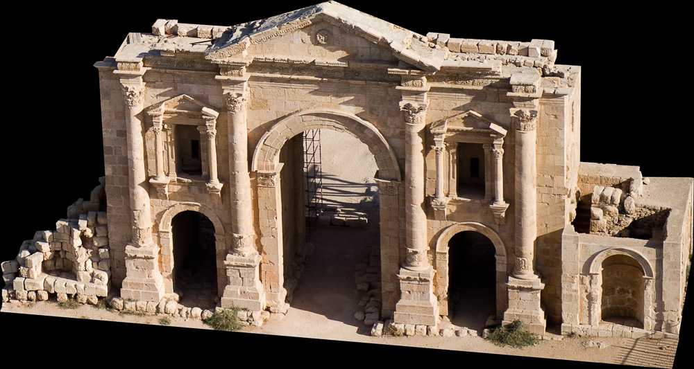




Staf
PAST
GIS for Archaeology
Data collection and drones for Rangers
Geospatial/Web Dev for Carbon, Climate, Land Management
NOW
Geospatial Dev for Digital Twins and 3D Web Mapping

Slide 7

Where do you work?
Geospatial Company?
Non-geo Company?
Researcher?
Government?
Independent?
What have I forgotten?

Slide 8

What do you do?
GIS Analysts?
Developers?
Data managers?
Project managers?

Slide 9






What do you know?
Leaflet
Cesium
NodeJS
NPM
Github
Docker
Cloud platforms?

Slide 10
A bit on the Workshop Aims...
Clone the Terriajs and TerriaMap git repositories to your local machine, setup the dev environment to run locally
Edit Config Files with VSCode or another code editor that you are comfortable with.
Add links to your desired datasets (publicly available ones)
For advanced users, deploy to the web as a public map!

Slide 11
How do you feel?
That is going to be too hard
That is going to be too easy

Slide 12
Crucial URLs
https://terria.io/
https://docs.terria.io/guide/
https://github.com/TerriaJS/
https://docs.terria.io/guide/contributing/development-environment/

Slide 13

Schedule
8:15 - 8:45 Overview of Terria
8:45 - 9:15 Examples together on screen
9:15 - 9:45 Development Environment and get running locally
- break -
10:00 - 10:30 Customising the look
10:30 - 11:15 Building your catalog
11:15 - 12:00 Deploying and testing

Slide 14
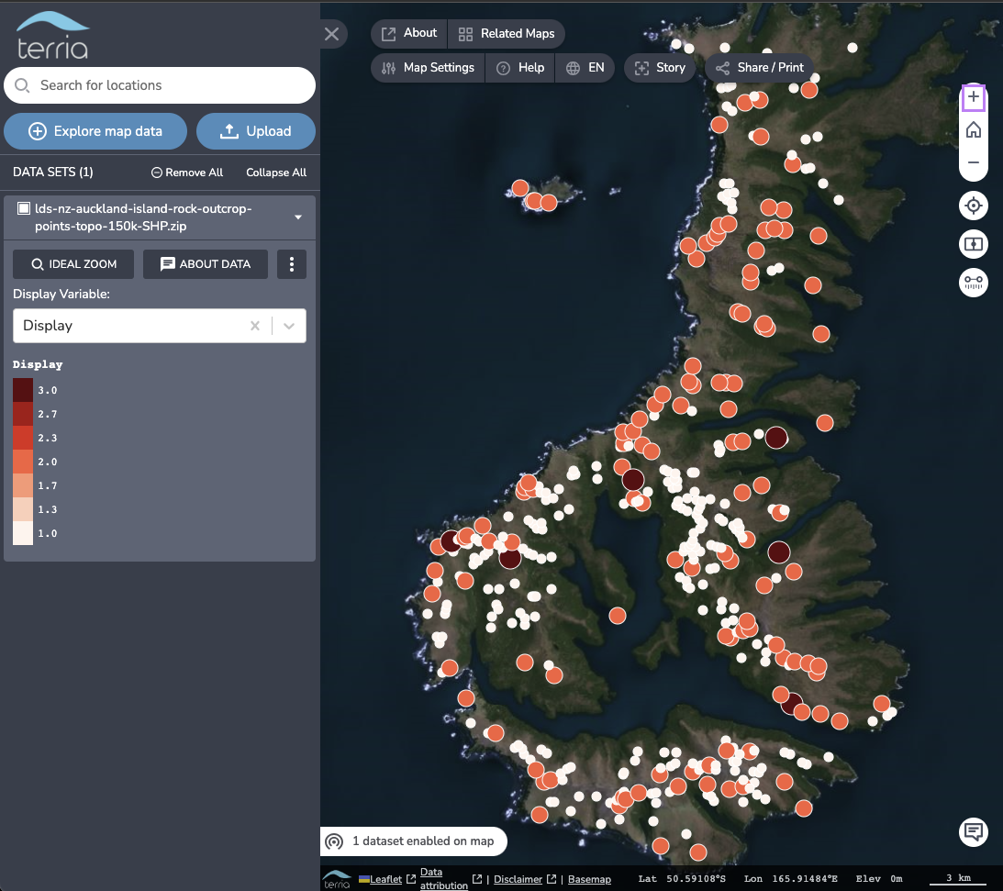
What is Terria?
Find, show and tell

Slide 15
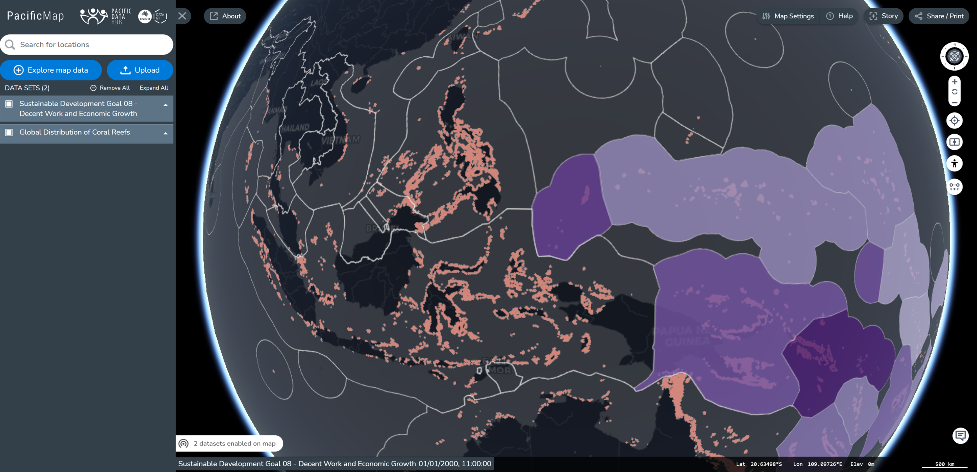
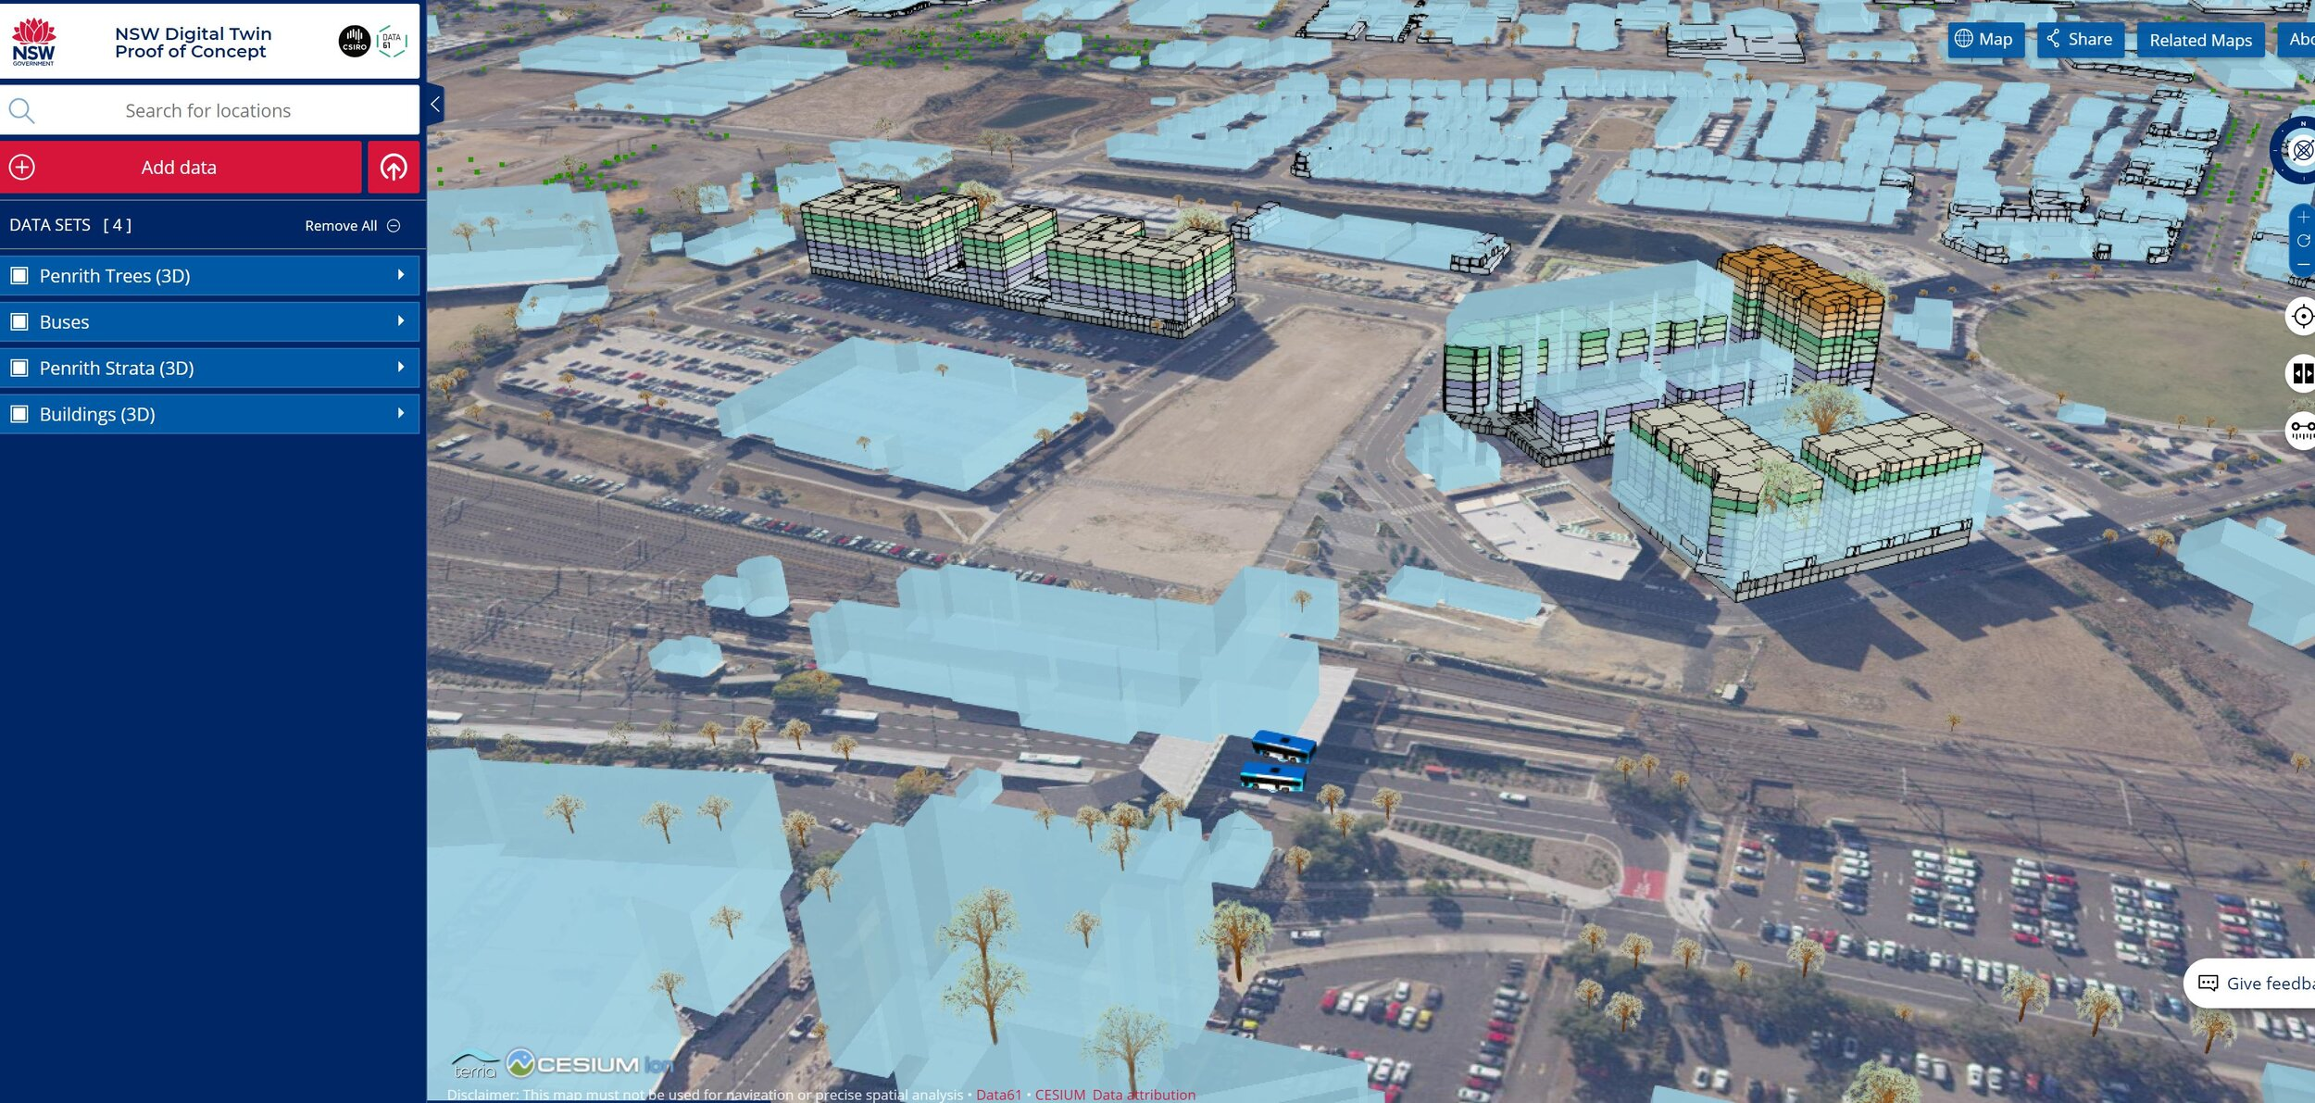
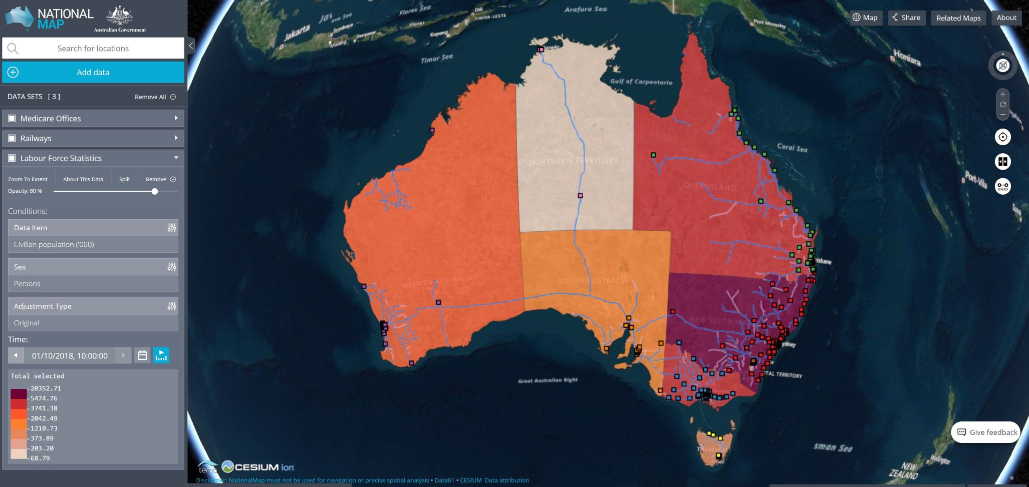
Open source framework to build Federated Spatial Data Explorers/ Geospatial Catalog Explorers
A web based spatial data viewer!
Great for bringing together datasets already on the web
Not a full blown GIS: "we don’t do analytics"
Open source
Lots of the hard work already done

Slide 16
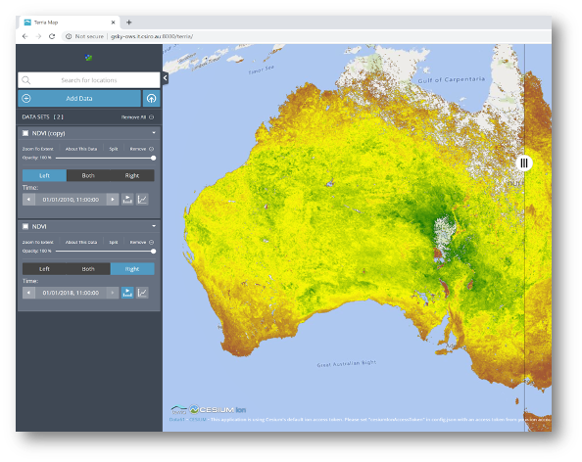
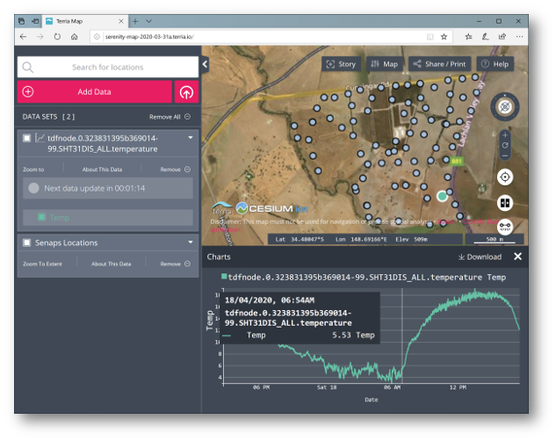
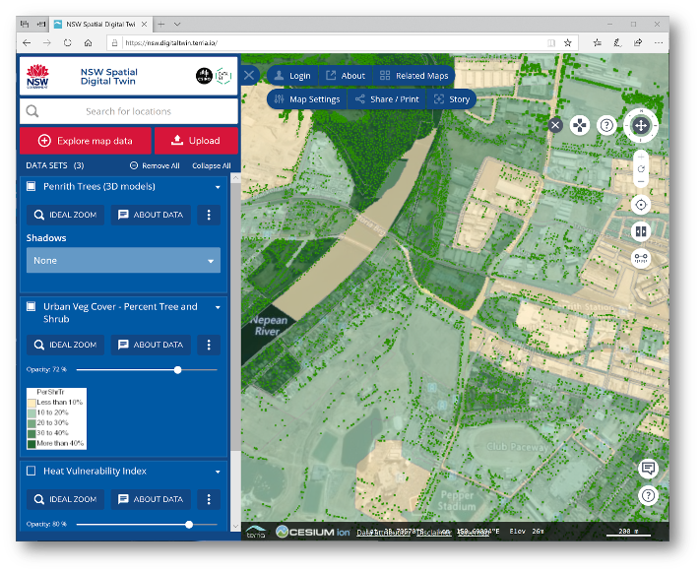
Open source framework to build Federated Spatial Data Explorers/ Geospatial Catalog Explorers

Slide 17
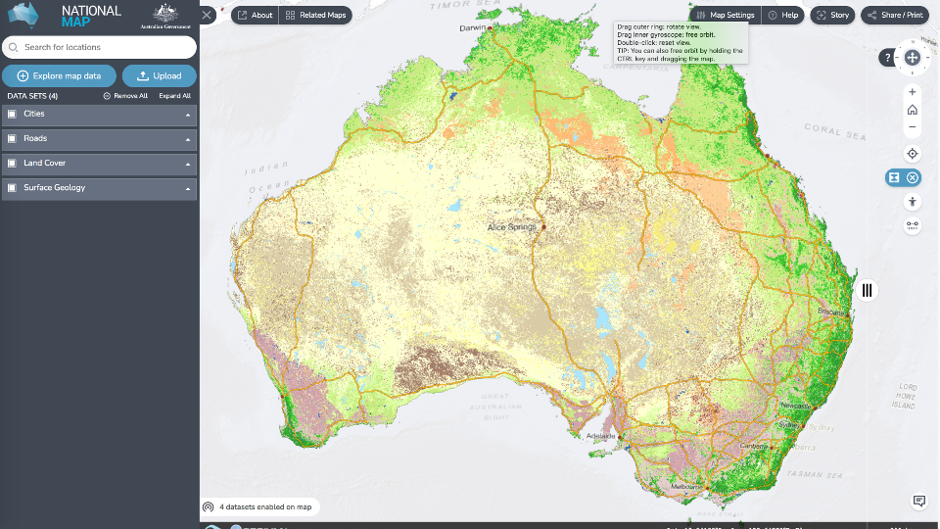
History- National Map Project!
NationalMap...
Provides easy access to over 13,000 datasets for use by government, business and the public
Allows federal, state and local government bodies to make their data open and available
Most of the data is accessed directly from the government department or agency that owns and manages the data, so you are getting the data straight from the source.
That’s 'Federation' we don’t make a copy of the data, we just bring it in direct from the source.

Slide 18
Many Different Terria Maps...
Same code – many different maps!
Map theme, config, and catalog specified in json files!
See https://terria.io/applications
National Map, NSW Spatial Digital Twin, QLD Spatial Digital Twin, Digital Twin Victoria, Digital Earth Australia, Digital Earth Africa, Pacific Map, National Drought Map, GeoGlam Rangelands and Pasture Productivity, etc etc!

Slide 19
Example Sharelinks / Stories
DEA has put together some great stories
https://maps.dea.ga.gov.au/#share=s-DEACoastlines&playStory=1
https://maps.dea.ga.gov.au/story/DEALandCover
Some great ones in Victoria – try on your phone!
https://www.land.vic.gov.au/maps-and-spatial/digital-twin-victoria/dtv-platform
And heres a basic one I made with some land management datasets
https://maps.dea.ga.gov.au/#share=s-9EgwTPejOLv8Ee35wlyr5mWfHE0

Slide 20
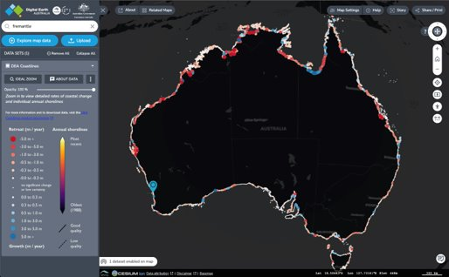
Practise!
Lets run through some
basic Terria stuff

Slide 21
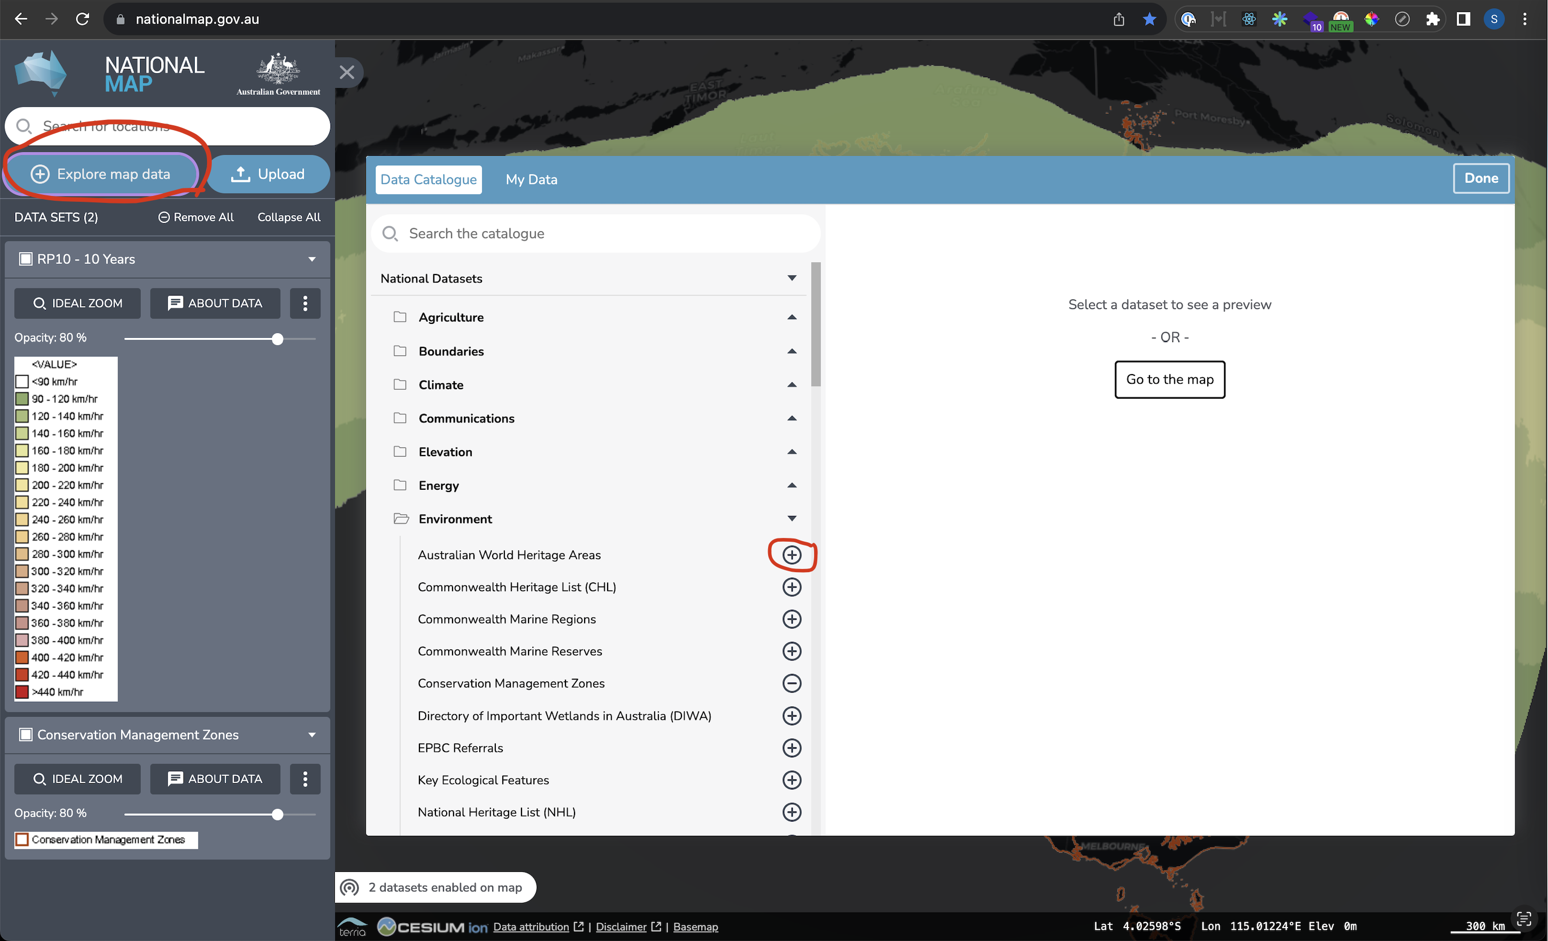
Exercise1: nationalmap.gov.au
Open
https://nationalmap.gov.au/
'Explore Map Data'
Add a couple of datasets you find interesting for Australia

Slide 22
Exercise2: Add publicly available data
Start a new map at https://nationalmap.gov.au/
Pan to Auckland
Go to https://data.linz.govt.nz/data/ and find a good WMS to add
Download some data as a shapefile, try drag and drop

Slide 23
Exercise3: Sharing
Share the map with a sharelink
Create a basic story

Slide 24
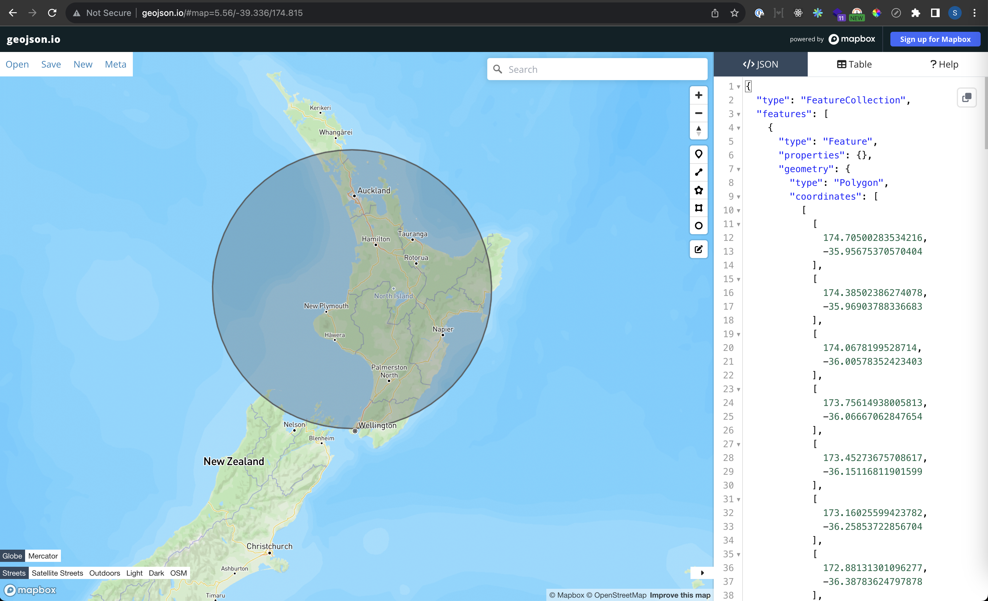
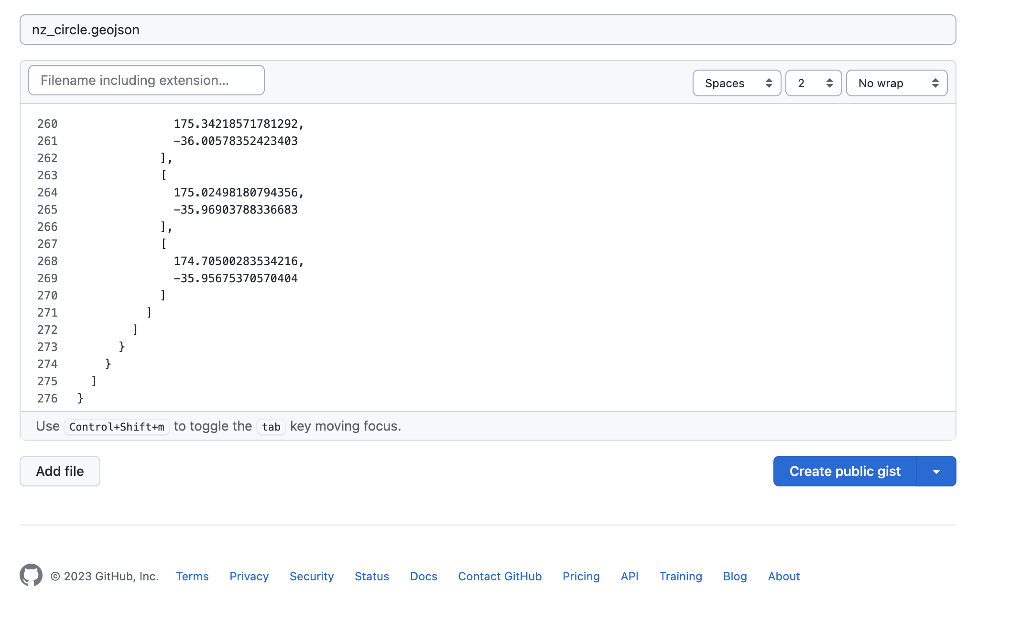
Exercise 4: Self hosted data
Create a vector dataset at http://geojson.io
Copy the geojson code
Self host at https://gist.github.com
Add this to your map
Copy the raw file link
Upload > My Data > Add Web Data

Slide 25
Making the Map Your Own
See the markdown instructions at
https://github.com/TerriaJS/workshops/tree/main/foss4g-auckland-2023/build-your-own-terriamap

Slide 26
Steps Summarised:
Access the workshop instructions:
https://github.com/TerriaJS/workshops/tree/main/foss4g-auckland-2023/build-your-own-terriamap
Download the repos
https://github.com/TerriaJS/terriajs
https://github.com/TerriaJS/TerriaMap
Configure dev environment
https://docs.terria.io/guide/contributing/development-environment/

Slide 27
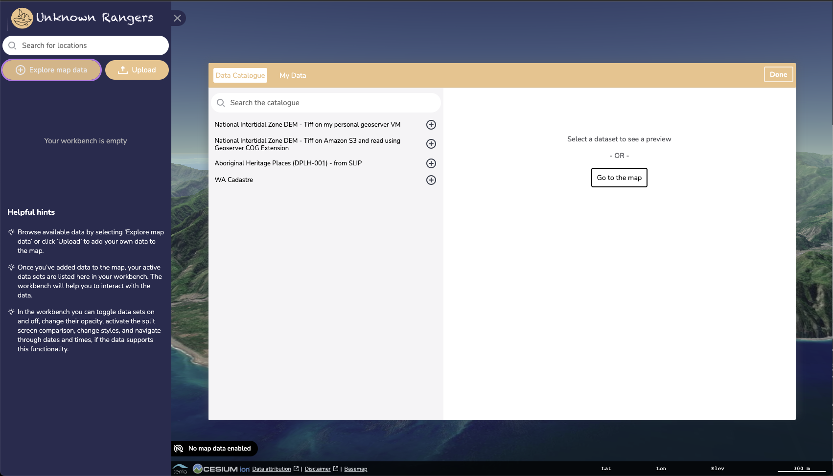
Steps Summarised:
Theme your map!
Colour scheme, title, logo
Build a catalog of datasets you are interested in
Make sure everything works locally
Deployment next!

Slide 28
Deploy your web map
Do this section last!

Slide 29
Simple deployment options
Static HTML hosting
Use a static hosting service like Github Pages or S3
Easy to set up without running any servers of your own
But no CORS proxy, so it can only show data from services that are CORS enabled
Hosting on a cloud server
Launch a server on a cloud service and use docker to setup your terria map instance
Includes terria proxy, which means the map can access data behind non-CORS enabled services

Slide 30
Github Pages
If you have:
an index.html
in a repository “myrepo”
in an account “myuser”
Then you have a website: myuser.github.io/myrepo (And a normal repository at github.com/myuser/myrepo)

Slide 31
Here’s one I prepared earlier
na9da.github.io/terriamap-static
Repository: github.com/na9da/terriamap-static

Slide 32
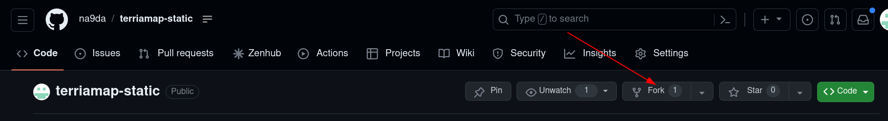
Fork static map repo
*As an alternative to forking, you can also do a release build and then copy the wwwroot folder to a new github repository
cd terriamap/
yarn run gulp release
cp –rf wwwroot ../terriamap-static

Slide 33
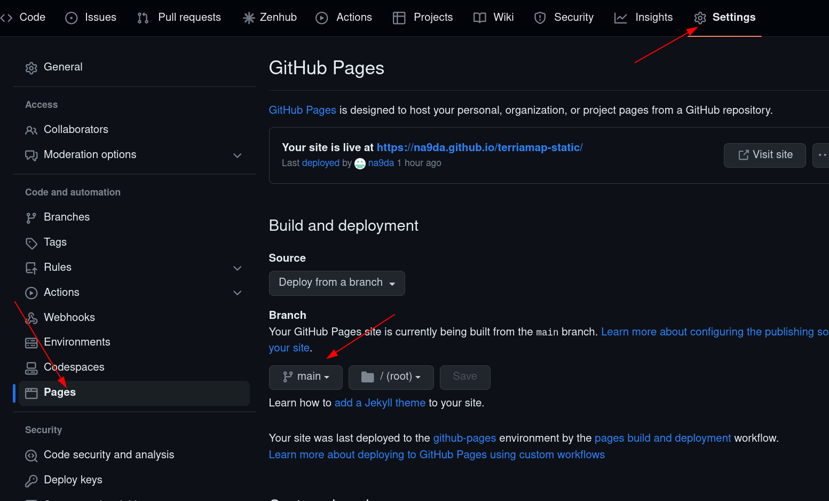
Setup github pages for your fork

Slide 34
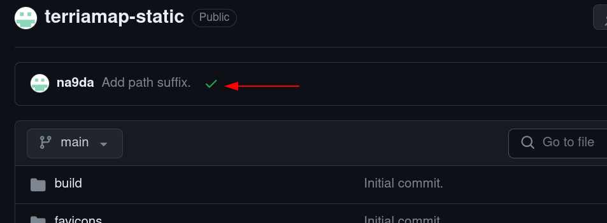
Wait for build to finish

Slide 35
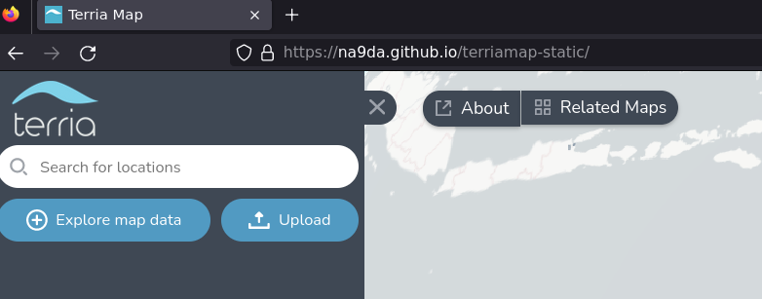
Load your map

Slide 36
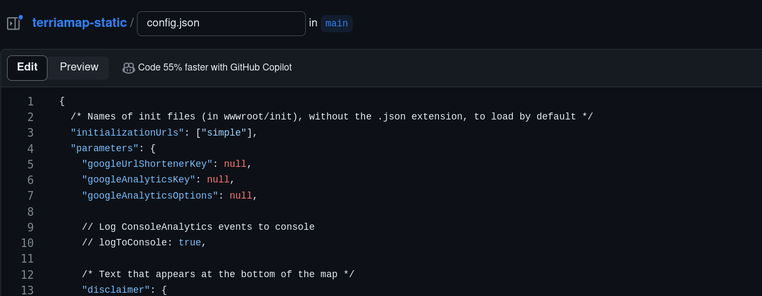
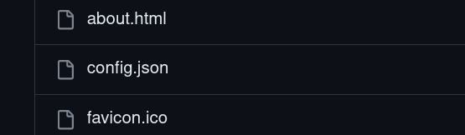
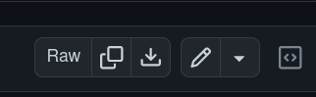
Editing config
terria.io/Documentation/Customizing/Config-JSON/

Slide 37
What else can I do with it?
Skin it
Embed it
Change basemaps
https://docs.terria.io/guide/customizing/

Slide 38
Why deploy to a server?
Extra services (CORS proxy etc)
Tweak code and rebuild
Tweak styles and rebuild

Slide 39
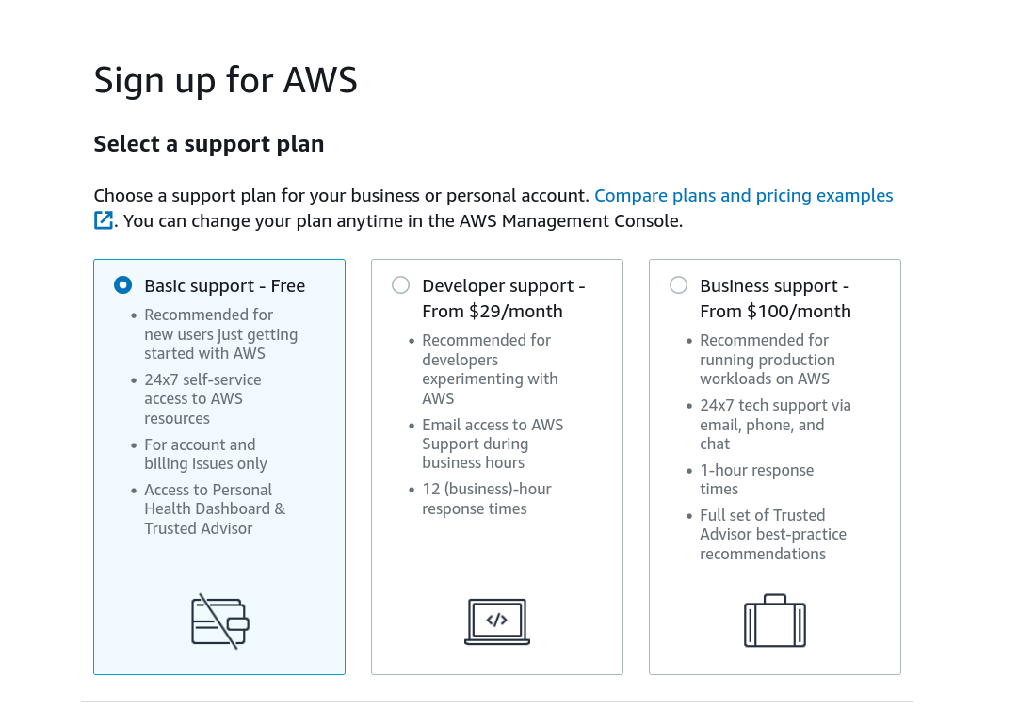
Deploying to S3

Slide 40
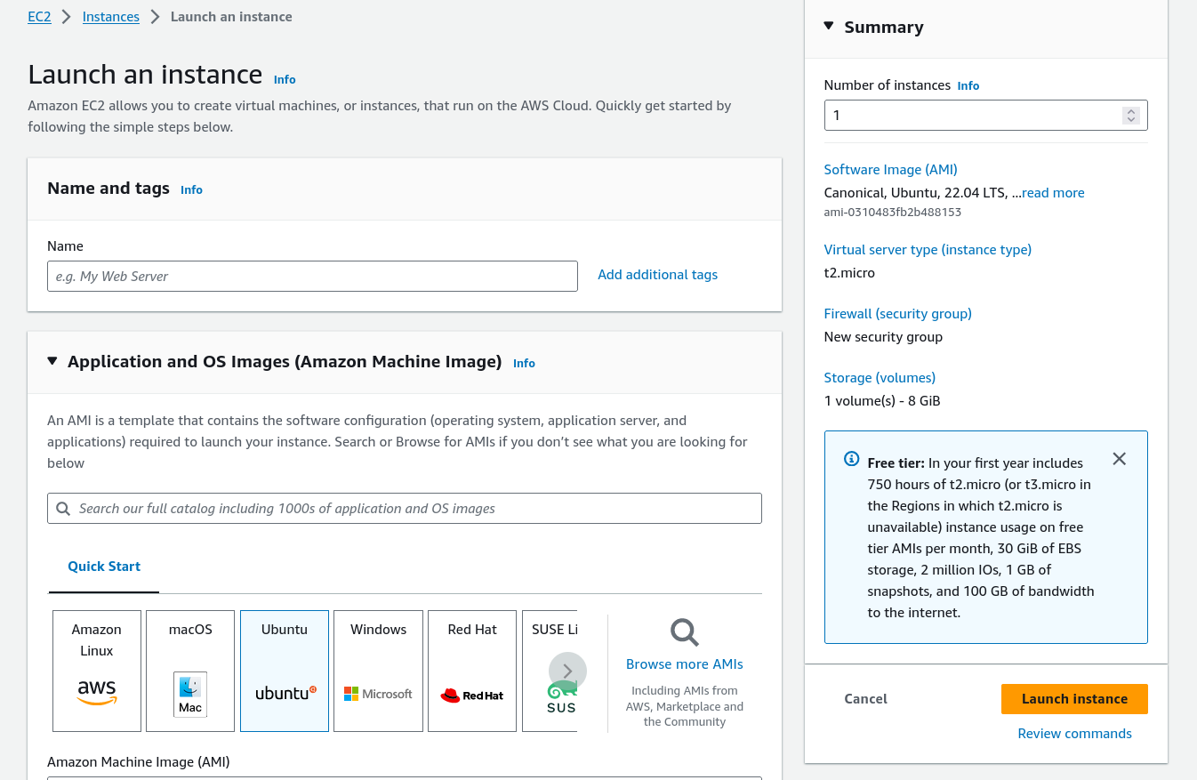

Slide 41

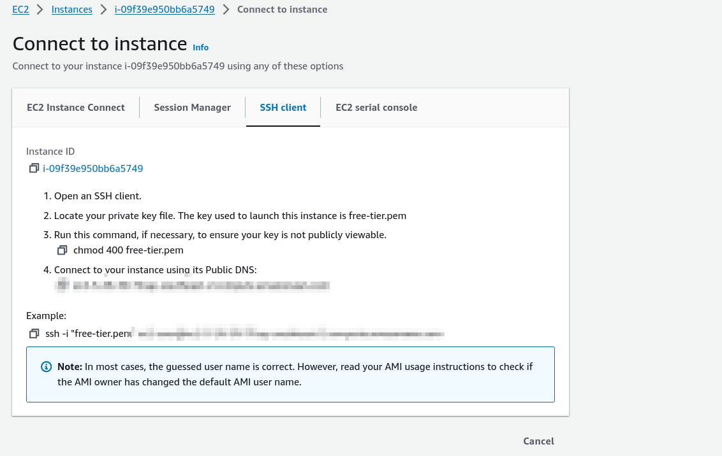
Connecting to your server

Slide 42
Running terria map using docker
sudo apt update
sudo apt upgrade
sudo apt install docker.io
docker run -d -p 3001:3001 ghcr.io/terriajs/terriamap
# more information in https://docs.terria.io/guide/getting-started/

Slide 43
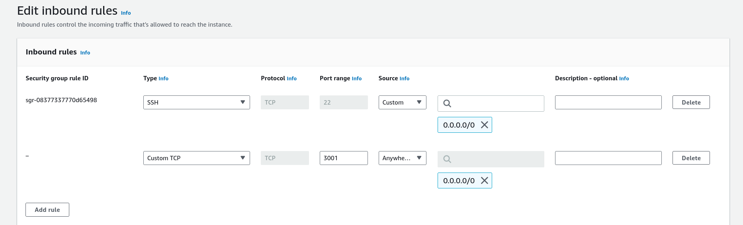
Opening port for public access

Slide 44
Thanks for Having Us!
We would like to thank all the contributors to the open source libraries on which Terria is built,
Thanks to the FOSS4G organising team,
Thanks to CSIRO and Data61 for flying us here,
And thanks to you for participating!

